Slide 1
SOFTWARE PROJECT LAB -1
PRESENTED BY
JITESH SUREKA
ROLL:BSSE 1115
SUPERVISED BY :
DR. AHMEDUL KABIR

Slide 2
Project Name : IMAGE PROCESSING TOOLS Language Used : C/ C++ GITHUB LINK: https://github.com/jsureka/SPL1

Slide 3
PROJECT MOTIVATION
Wanted to explore the image manipulation side of the technology field
Want to work on a bigger project which will require rigorous work on image manipulation

Slide 4
PROJECT IDEA
Take Image as Input
Menu containing a number of image processing tools
Increment or decrement options will be given for each image modification tool
Output Image will be saved as a new file
Primarily, the project will focus on implementing :
Smoothing, Zooming, Sharpening, Gray-Scaling and Edge Detection

Slide 5
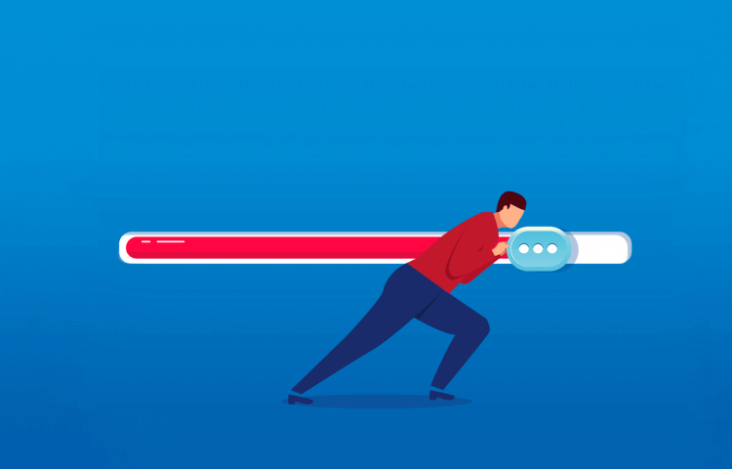
PROGRESS SO FAR
Reading the image data
Write the header in the output file
Process the pixels as required
GrayScaling
Darkening
Write the processed image pixels in the output file

Slide 6
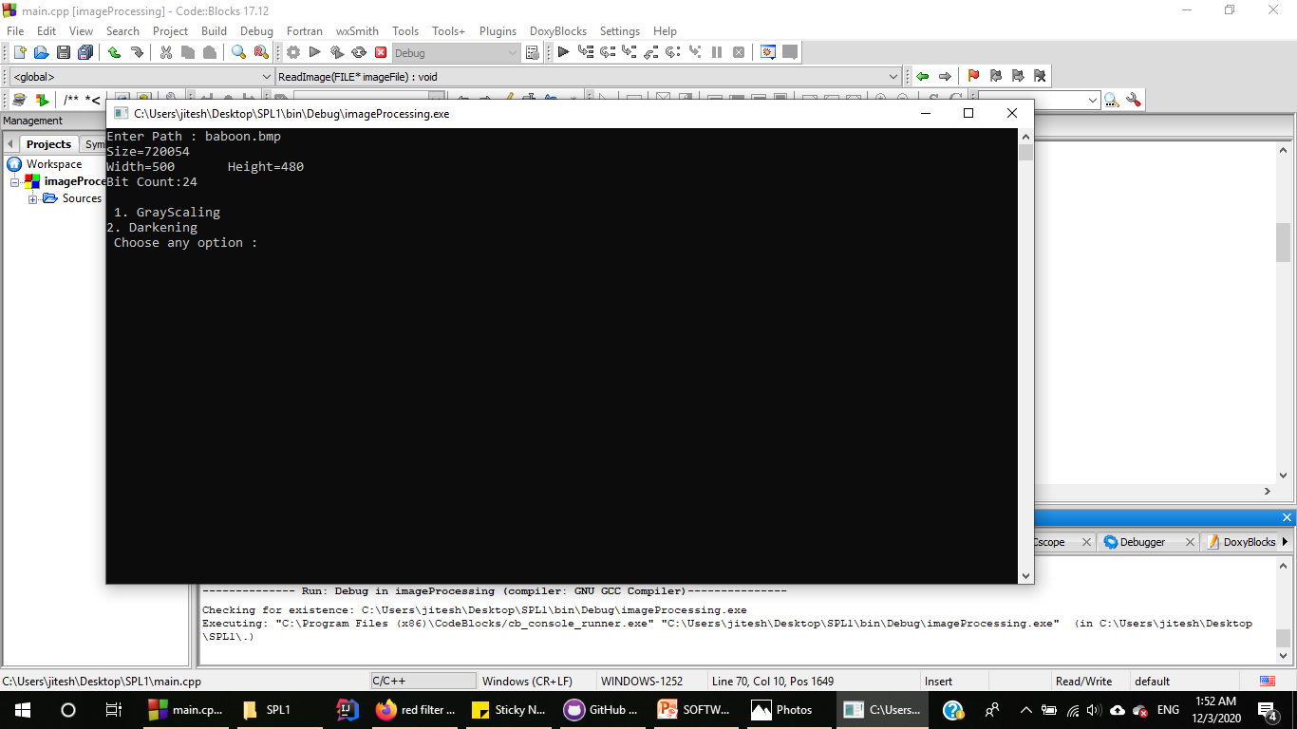
TAKING PATH AS INPUT
Taking path as input until it takes
a proper file path as input

Slide 7
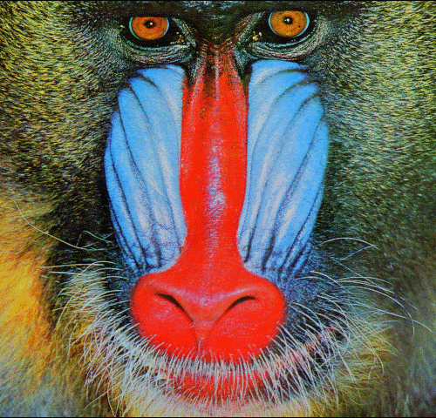
READING AN IMAGE
Reading the baboon.bmp image as input
Reading header info
Reading pixel data
Storing the datas

Slide 8
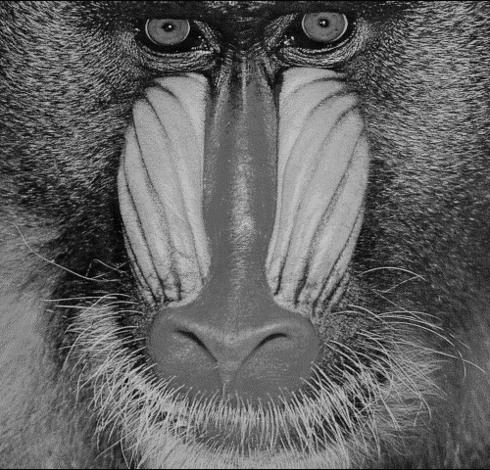
WRITING THE PROCESSED IMAGE
Algorithm :
pixels[totalsize ]
While (index<totalsize)
Take Average of RGB i.e. (R+G+B)/3
Index+=3

Slide 9
STUDIED SO FAR
Reading and writing an image file
Structure of a .bmp format image file
Writing the headers in output file
Modifying the pixel data

Slide 10
FUTURE IMPLEMENTATION PLANS
Adding further features for image processing including edge detection, gray-scaling and smoothing
Adding user menu to the program
Exception Handling

Slide 11
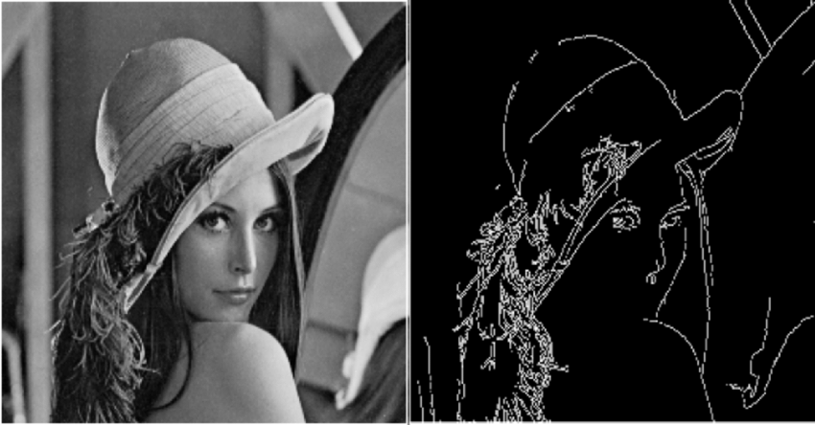
EXAMPLE – EDGE DETECTION

Slide 12
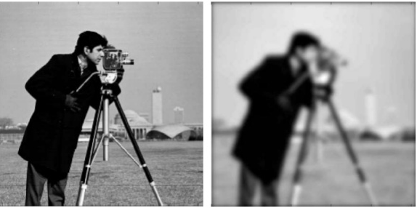
EXAMPLE - SMOOTHING

Slide 13
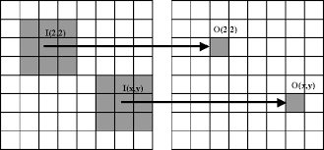
EXAMPLE – MEDIAN FILTER

Slide 14
REFERENCE LINKS
https://www.google.com/url?sa=i&url=https%3A%2F%2Fwww.justinmind.com%2Fblog%2F10-inspiring-progress-bars-that-delight-users%2F&psig=AOvVaw3lVbNc_-Pl0g2vKqQlKWJa&ust=1584001485547000&source=images&cd=vfe&ved=0CAMQjB
https://en.wikipedia.org/wiki/BMP_file_format
http://homepages.inf.ed.ac.uk/rbf/BOOKS/PHILLIPS/cips2ed.pdf
https://image.slidesharecdn.com/smoothing-180424114019/95/smoothing-in-digital-image-processing-11-638.jpg?cb=1524570146
https://www.researchgate.net/profile/Josin_Hippolitus/publication/311770756/figure/fig2/AS:468112656080898@1488618162979/left-original-image-right-image-after-edge-detection.png

